Slide 2
World Sleep Day 2023 @ AmLife
Delegate: Mr. Lew Mun Yee
Affiliations: Am Life International Sdn. Bhd., Malaysia
Short Bio: AmLife established its sleep healthcare business in 2014. AmLife has pioneered the combination of bedding equipment and Japan’s state-of-the-art technology to expand the unlimited potential of the sleep healthcare market, providing a brand new health solution for modern-day people, which they can use every day. As an organization that cares for its community, AmLife has launched a nationwide health program that helps people tackle the problem of aging from its root, rendering the body more dynamic and rejuvenated.
AmLife strives to incorporate the healthcare concept into the daily lives of people's households using the “easy to use” and “ultimate winning” marketing strategy. It has developed many popular high-tech products surrounding the “sleep healthcare” concept with sustainable operation as its fundamental development philosophy, building a competent market surveillance team and brand operations team to significantly boost the Company’s brand awareness.
Activities: AmLife International conducted a public awareness campaign to promote World Sleep Day and take turns held in three countries: Malaysia, Hong Kong, and Taiwan.

Slide 3
World Sleep Day Opening Video

Slide 4
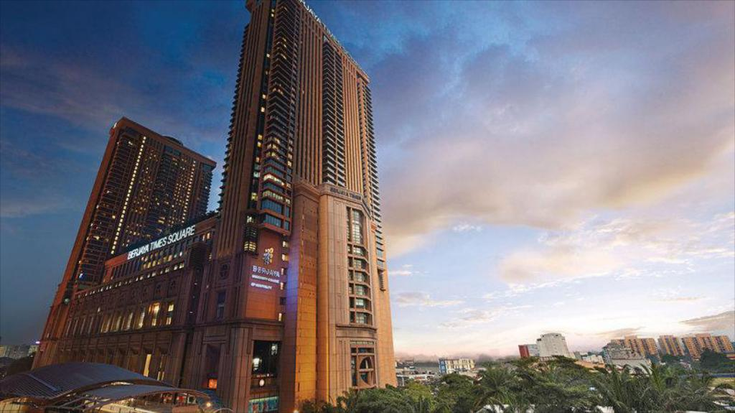
世界睡眠日 2023
MALAYSIA
MALAYSIA
Date : 05 March 2023 (Sunday)
Time : 9:00am – 6:00 pm
Venue : Berjaya Times Square Hotel, Kuala Lumpur (Manhattan Ballroom, Level 14)
Total Participant: 700

Slide 5
Main Guest Speaker:
Dr Ariel B. Neikrug, PhD
Health clinical psychologist and sleep medicine specialist from the United States
Assistant Clinical Professor, Psychiatry & Human Behavior, School of Medicine, University of California, Irvine
Dr. Neikrug has conducted more than 30 clinical researches and published his research results in international medical journals.
MALAYSIA
Topic: SLEEP AND AGING
Insight:
Sleep is essential for physical and mental health as it helps in rest and recovery, memory consolidation, hormone regulation, immune system support, and emotional regulation. However, insomnia is a common problem with up to 40% of patients in primary care reporting sleep difficulties. Chronic insomnia can increase the risk of cardiovascular disease, oxidative stress, inflammatory response, cortisol and insulin resistance. Sleep disturbances are related to the aging process, disease risk, and pathophysiology such as Alzheimer's disease. It is crucial to prioritize getting at least 7 hours of high-quality sleep, develop a sleep routine, set up a sleep-friendly environment, and seek medical help if needed. Not getting enough sleep can accelerate the aging process.

Slide 6
Main Guest Speaker:
Dr. Billy Lee Bing Li
MD, MC, MAIC
Appointed Fellow of AMS, F.M.A.S.
Stem Cell Therapy Specialist in Regenerative Medicine
Participated in the stem cell research team directed by UKM
Served in Kuala Lumpur Hospital, a Malaysian government-owned public hospital
Graduated from Medical University in Russia
Regenerative medicine R&D team serves as Chief Medical Director
MALAYSIA
Topic: STEM CELL TECHNOLOGY: REGENERATIVE & ANTI-AGING
Insight:
Stem cells play a crucial role in regenerative medicine because they have the unique ability to differentiate into specialized cells, making them a valuable resource for repairing and regenerating damaged tissues and organs. Researchers are exploring the use of stem cells to treat a wide range of medical conditions, including spinal cord injuries, heart disease, and diabetes.
In summary, stem cells are a crucial component of regenerative medicine, as they have the unique ability to differentiate into specialized cells and promote tissue regeneration. The use of stem cells in regenerative medicine holds great promise for the treatment of a wide range of medical conditions.

Slide 7
Sleep Ambassador:
Siow Hui Mei
Well-known news anchor and TV host in Malaysia
MALAYSIA
Malaysia's renowned news anchor, Siow Hui Mei, not only attended the 2023 World Sleep Day event organized by AmLife, but also kicked off this highly acclaimed health conference!
Siow Hui Mei believes in the importance of sleep. On stage, she openly admitted that as a working mother, sufficient sleep is particularly important and precious to her.
Siow Hui Mei said she was honored to attend the World Sleep Day event and spread awareness about the importance of good sleep to the public. Finally, she also urged everyone, "Sleep is really important for overall health, so please make sure to get enough sleep!"

Slide 8
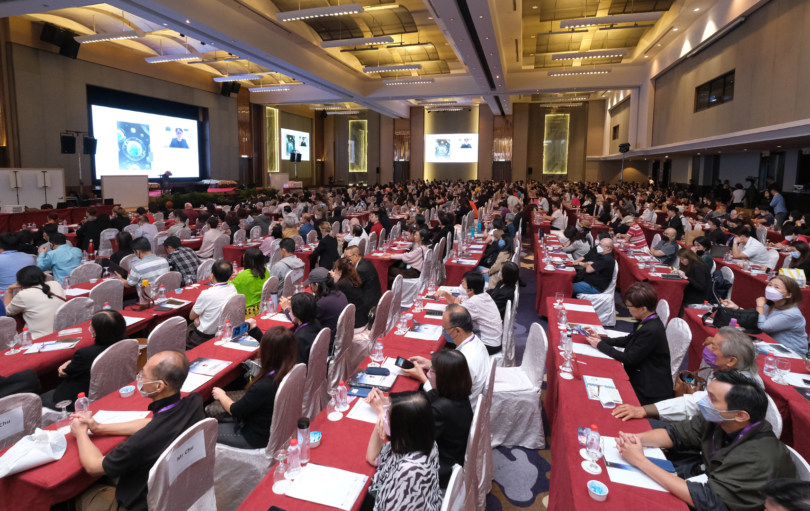
MALAYSIA

Slide 9
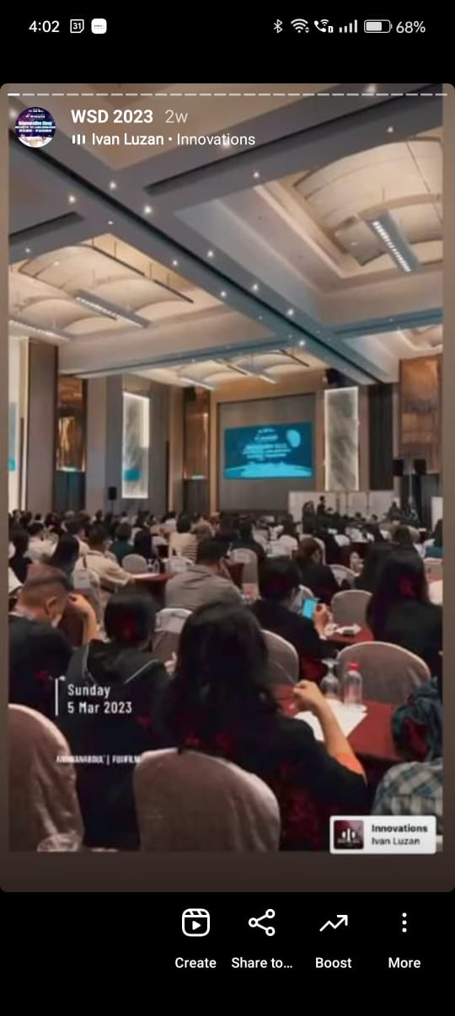
Instagram Story
https://www.instagram.com/s/aGlnaGxpZ2h0OjE3OTgyNTM2NTkzOTg4MTgy?story_media_id=3051512308672326400_6201206566&igshid=MDJmNzVkMjY=
MALAYSIA

Slide 10
世界睡眠日 2023
HONG KONG
HONG KONG
Date : 12 March 2023 (Sunday)
Time : 10:00am – 5:00pm
Venue : The Cityview, Hong Kong
Total Participant: 53

Slide 11
Guest Speaker:
Dr Karen Lui
Medical doctor graduated from India in 2017.
Working experience since 2017 in Sabah goverment hospital.
Work in psychiatric department from 2019-2022.
Able to provide accurate diagnosis and comfortable treatment to patients with mental disorders and insomnia.
Currently practising as medical consultant in AlphaCelle clinic.
Passionate about wellness and helping people achieve youth and healthy lifestyle through stem cells.
HONG KONG
Topic: REGENERATIVE SLEEP: THE KEY TO ANTI-AGING
Insight:
Sleep is essential for maintaining good health and preventing age-related problems. Poor sleep quality can lead to serious health issues, impact the skin's aging process, and impair the regeneration of cells. Electric potential therapy has been shown to be an effective treatment for insomnia, enabling individuals to sleep for longer durations and improve sleep quality. By prioritizing regenerative sleep, we can improve our health and reduce the risk of age-related problems.

Slide 12
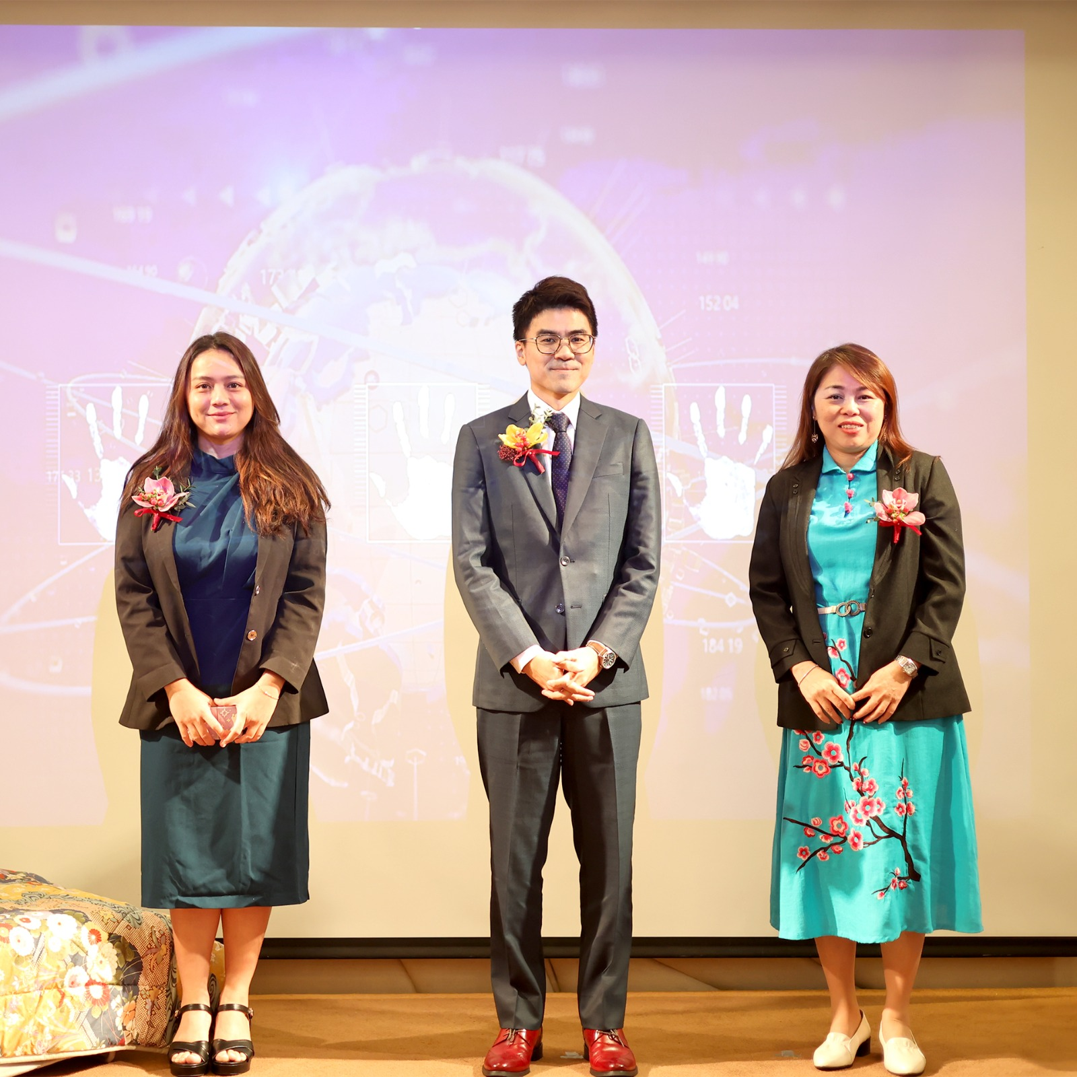
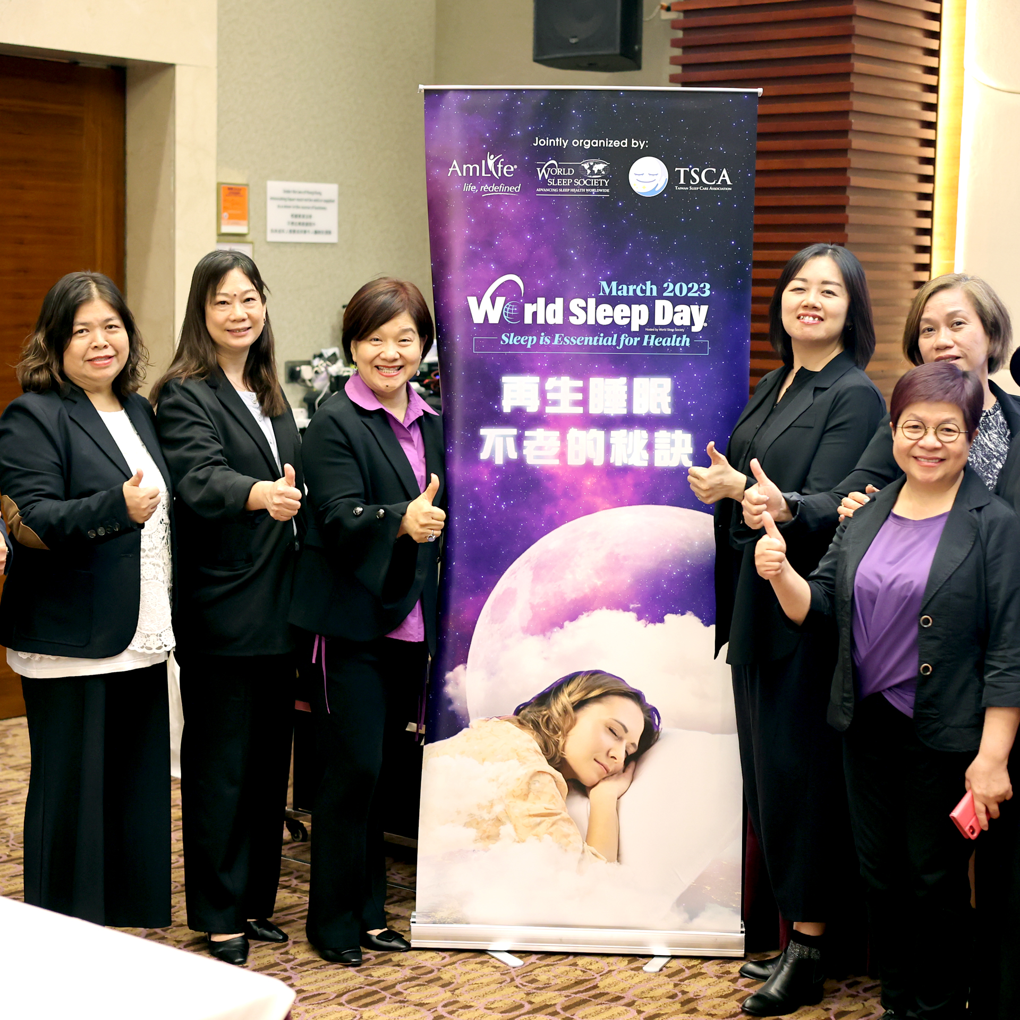
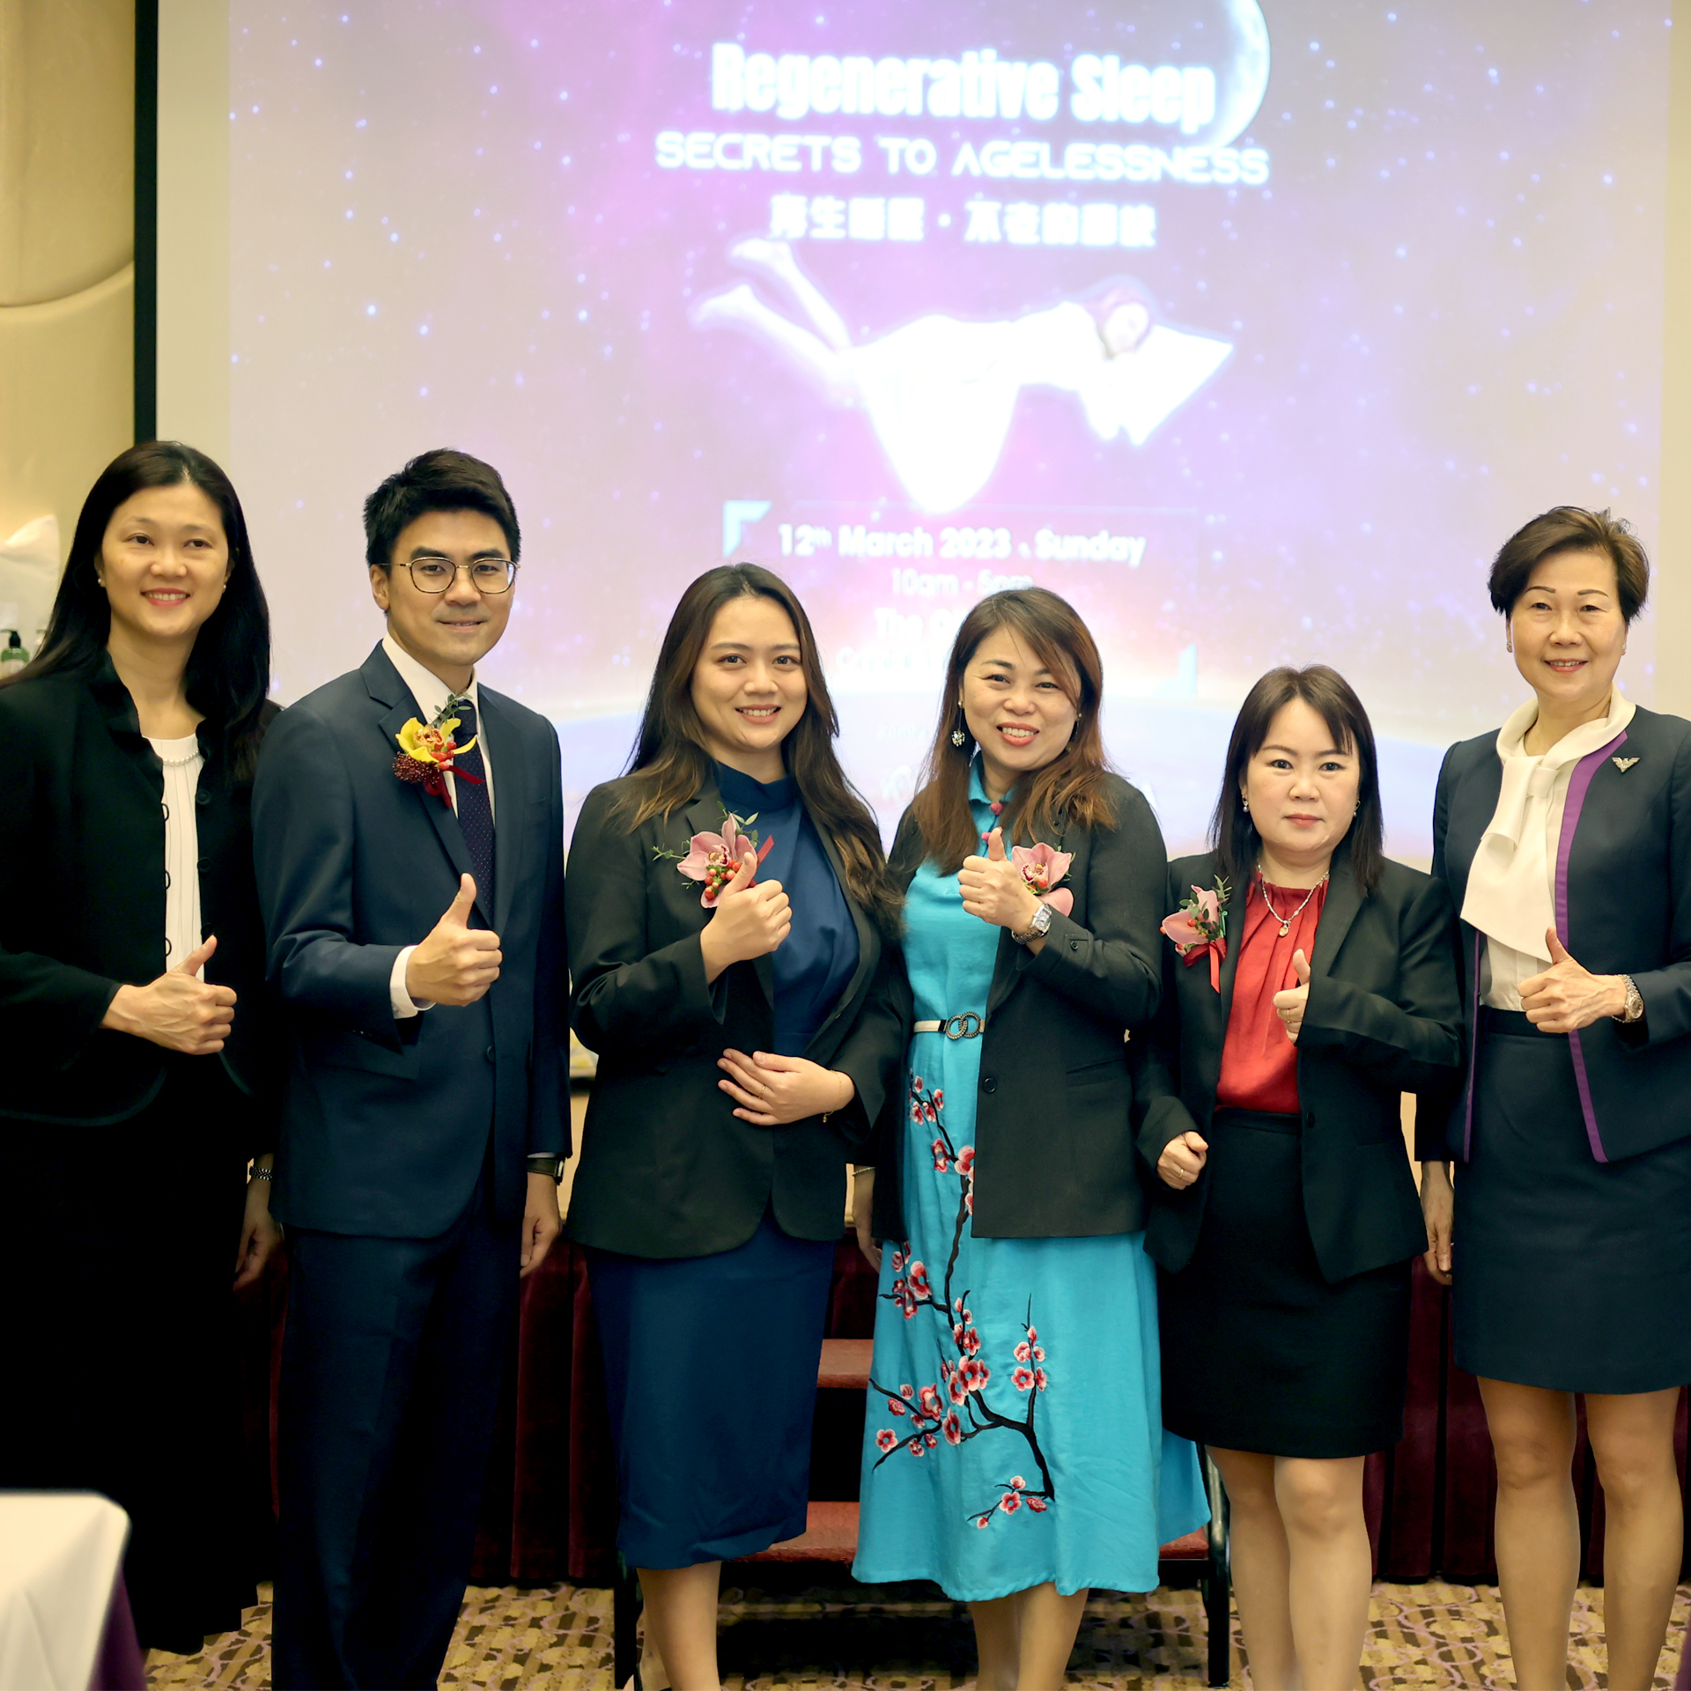
HONG KONG

Slide 13
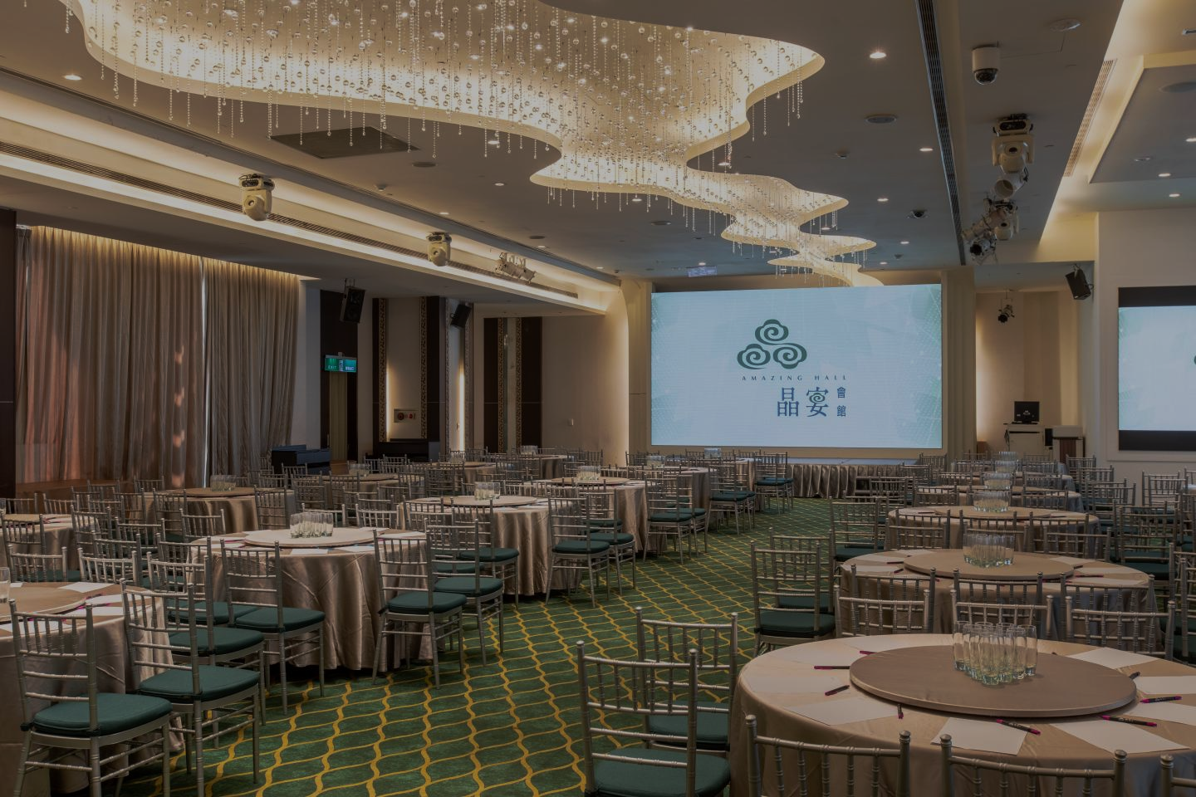
世界睡眠日 2023
TAIWAN
TAIWAN
Date : 18 March 2022 (Saturday)
Time : 9.00am – 5.30pm
Venue : Amazing Hall Minquan, Taipei
Total Participant: 137

Slide 14
Guest Speaker:
Dr Karen Lui
Medical doctor graduated from India in 2017.
Working experience since 2017 in Sabah goverment hospital.
Work in psychiatric department from 2019-2022.
Able to provide accurate diagnosis and comfortable treatment to patients with mental disorders and insomnia.
Currently practising as medical consultant in AlphaCelle clinic.
Passionate about wellness and helping people achieve youth and healthy lifestyle through stem cells.
TAIWAN
Topic: REGENERATIVE SLEEP: THE KEY TO ANTI-AGING
Insight:
Sleep is essential for maintaining good health and preventing age-related problems. Poor sleep quality can lead to serious health issues, impact the skin's aging process, and impair the regeneration of cells. Electric potential therapy has been shown to be an effective treatment for insomnia, enabling individuals to sleep for longer durations and improve sleep quality. By prioritizing regenerative sleep, we can improve our health and reduce the risk of age-related problems.

Slide 15
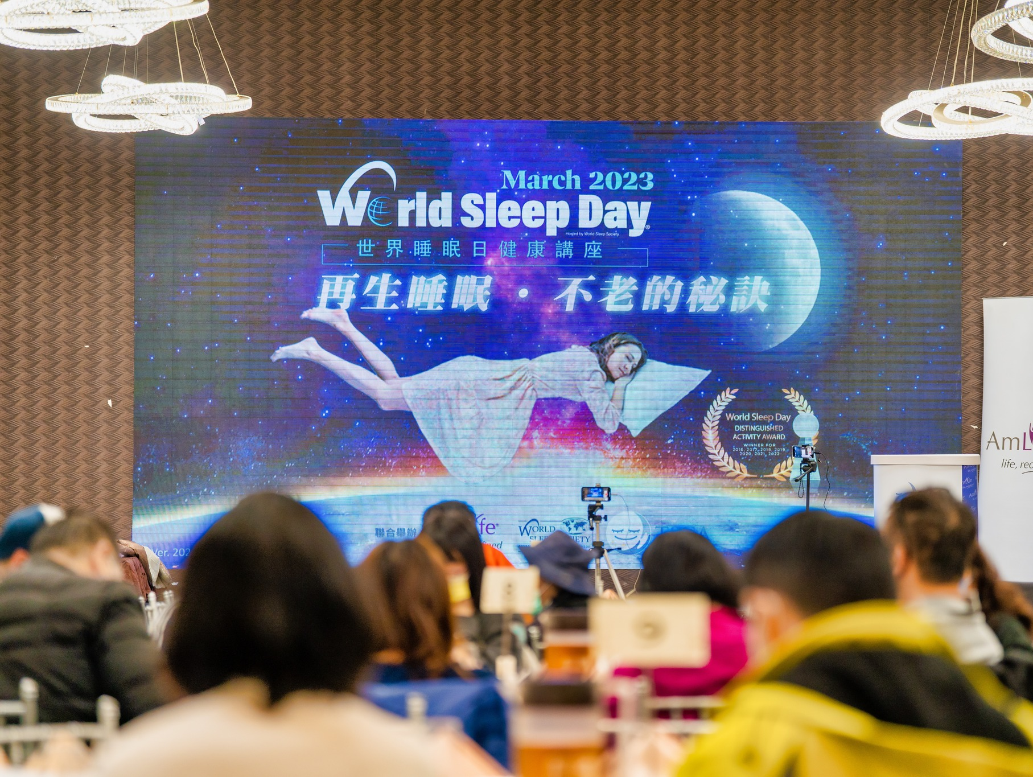
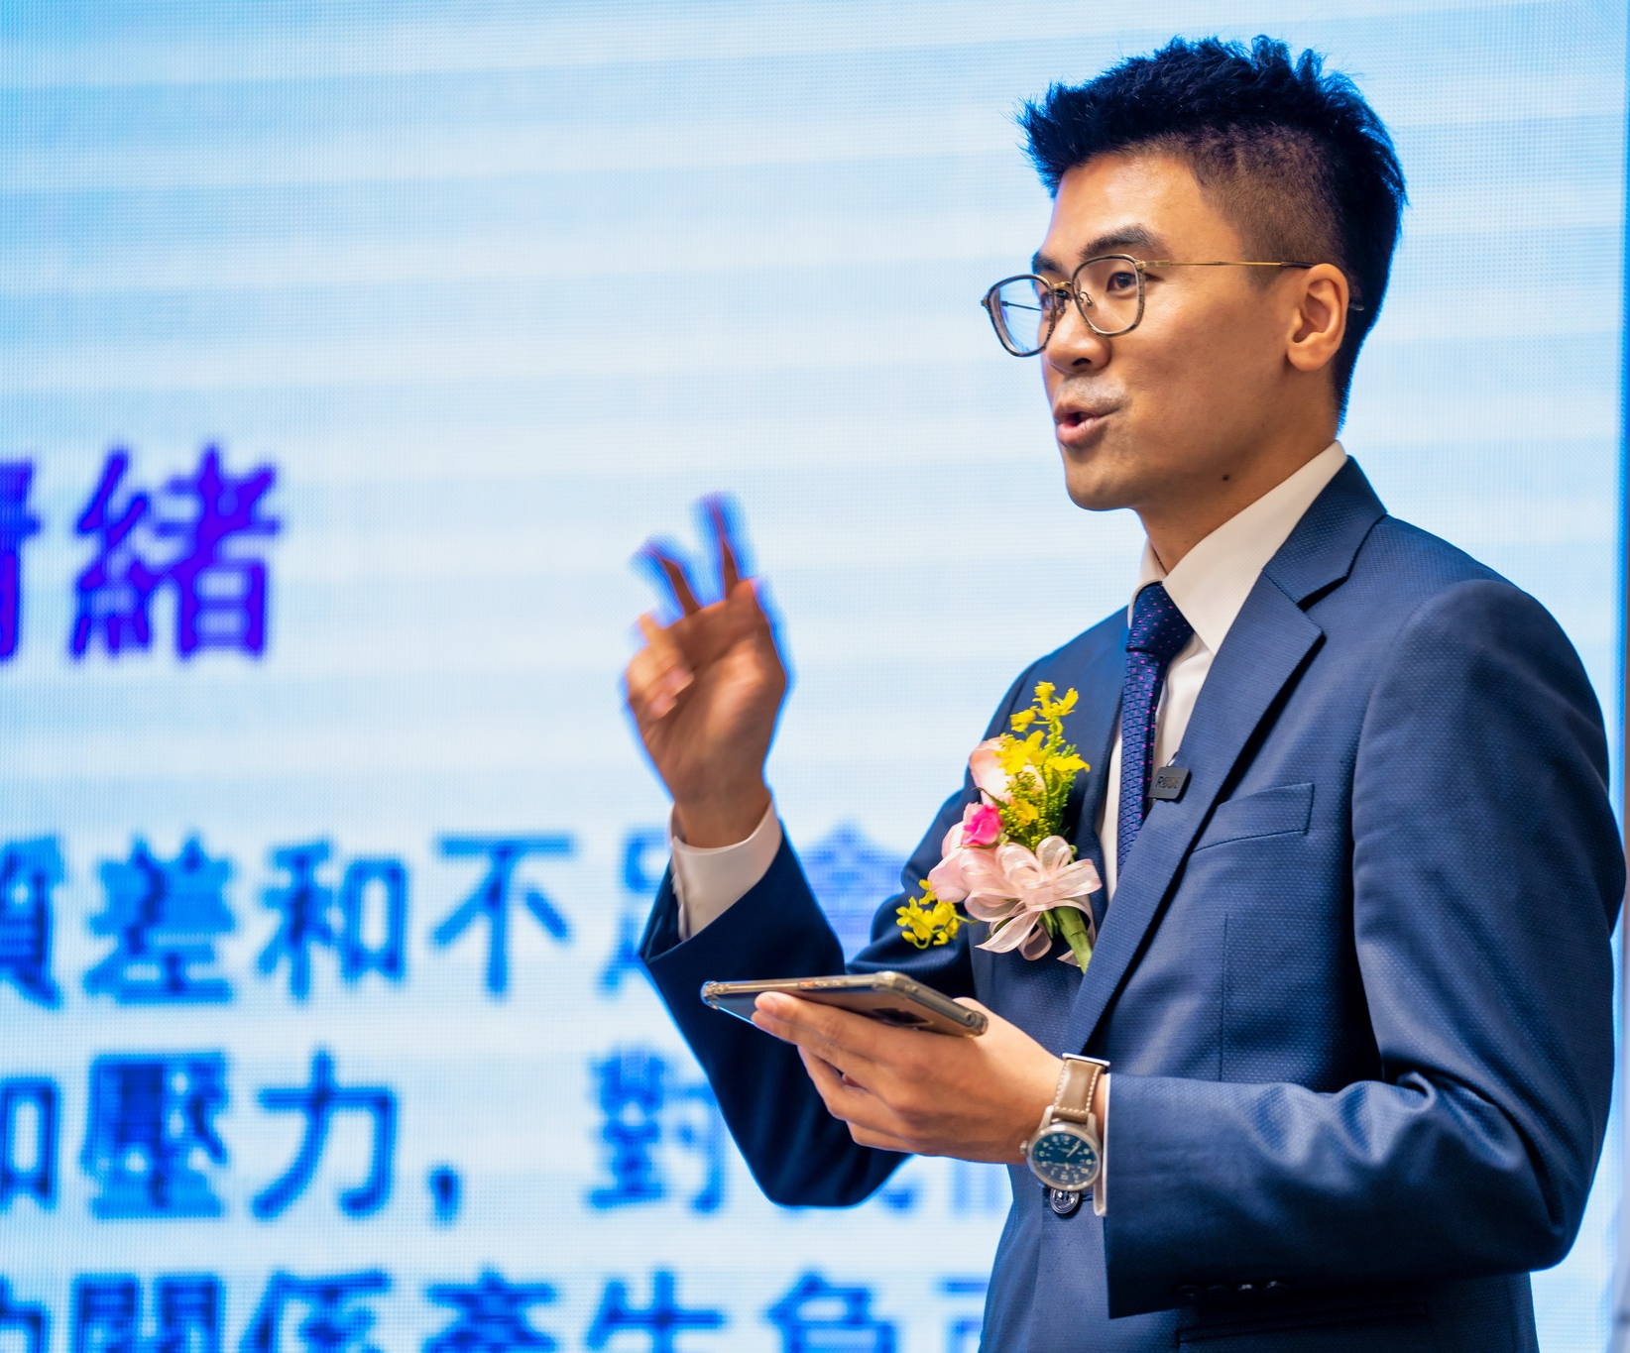
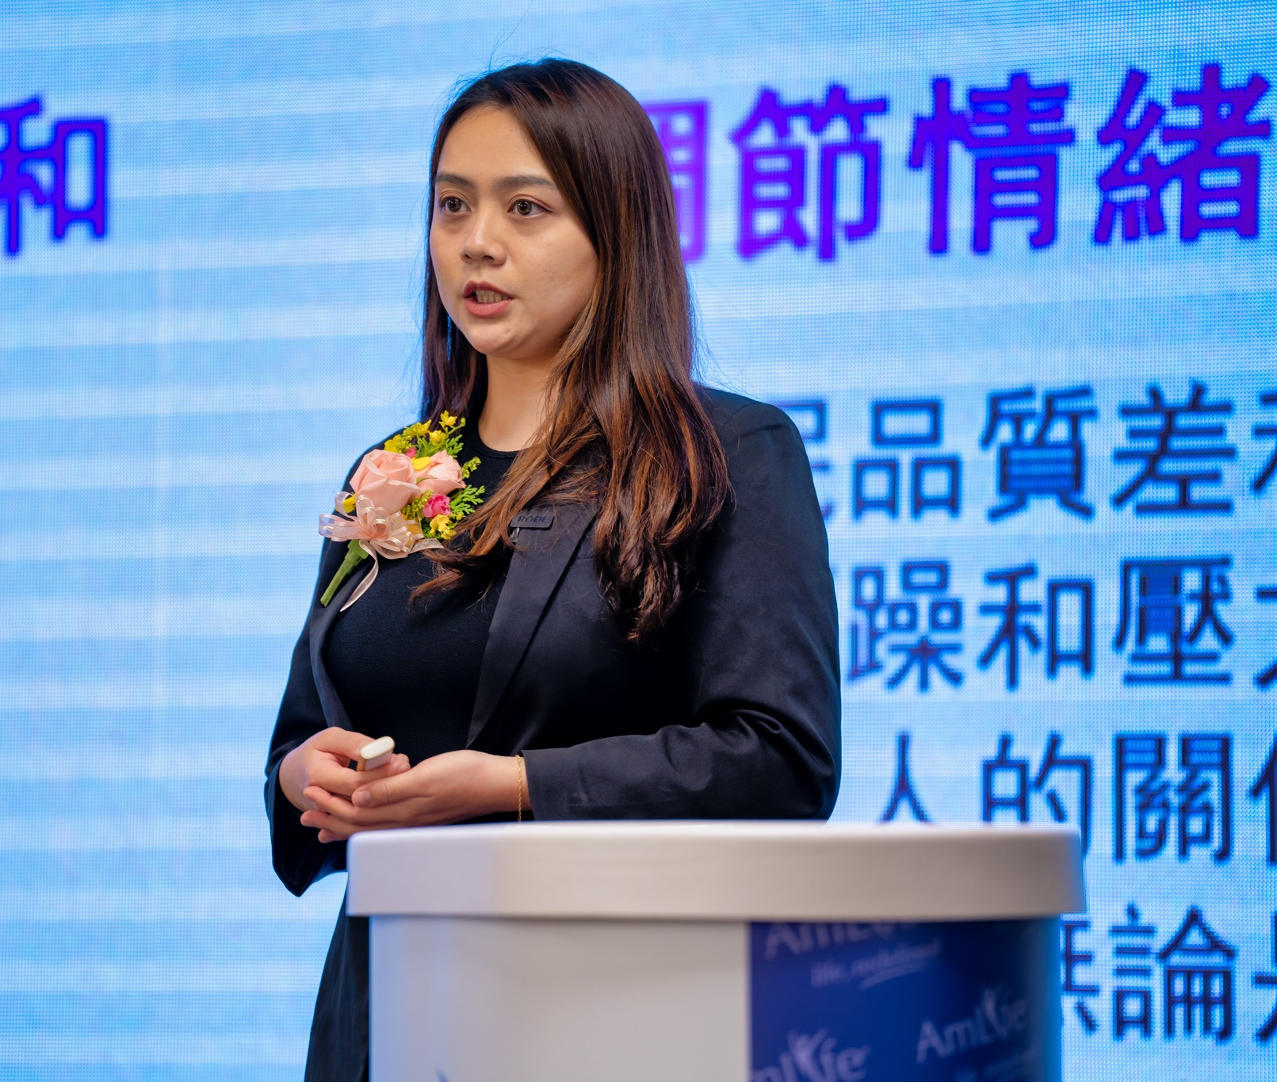
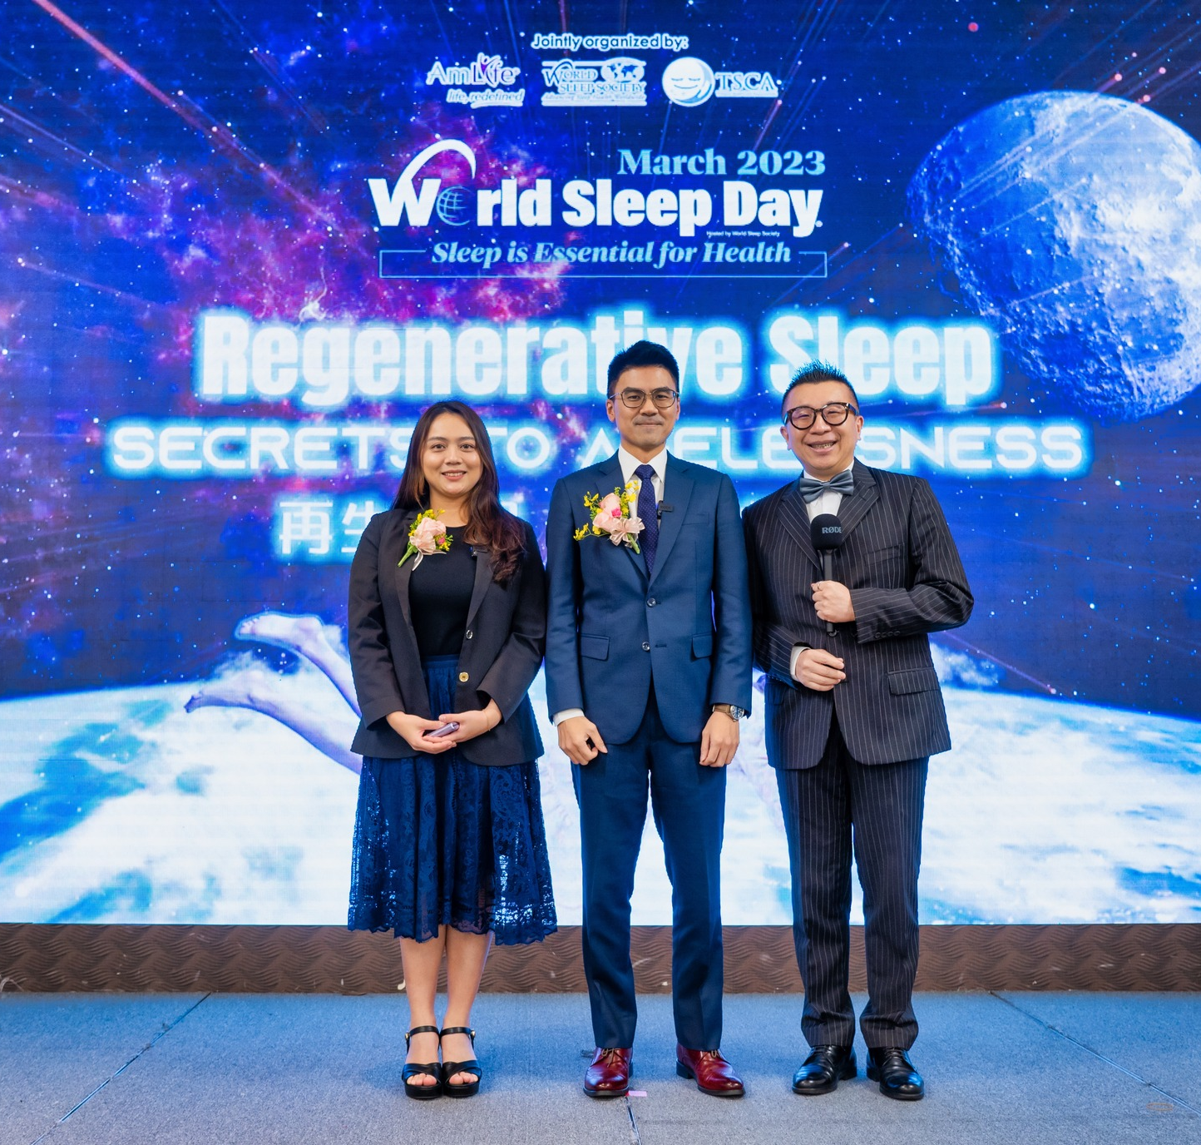
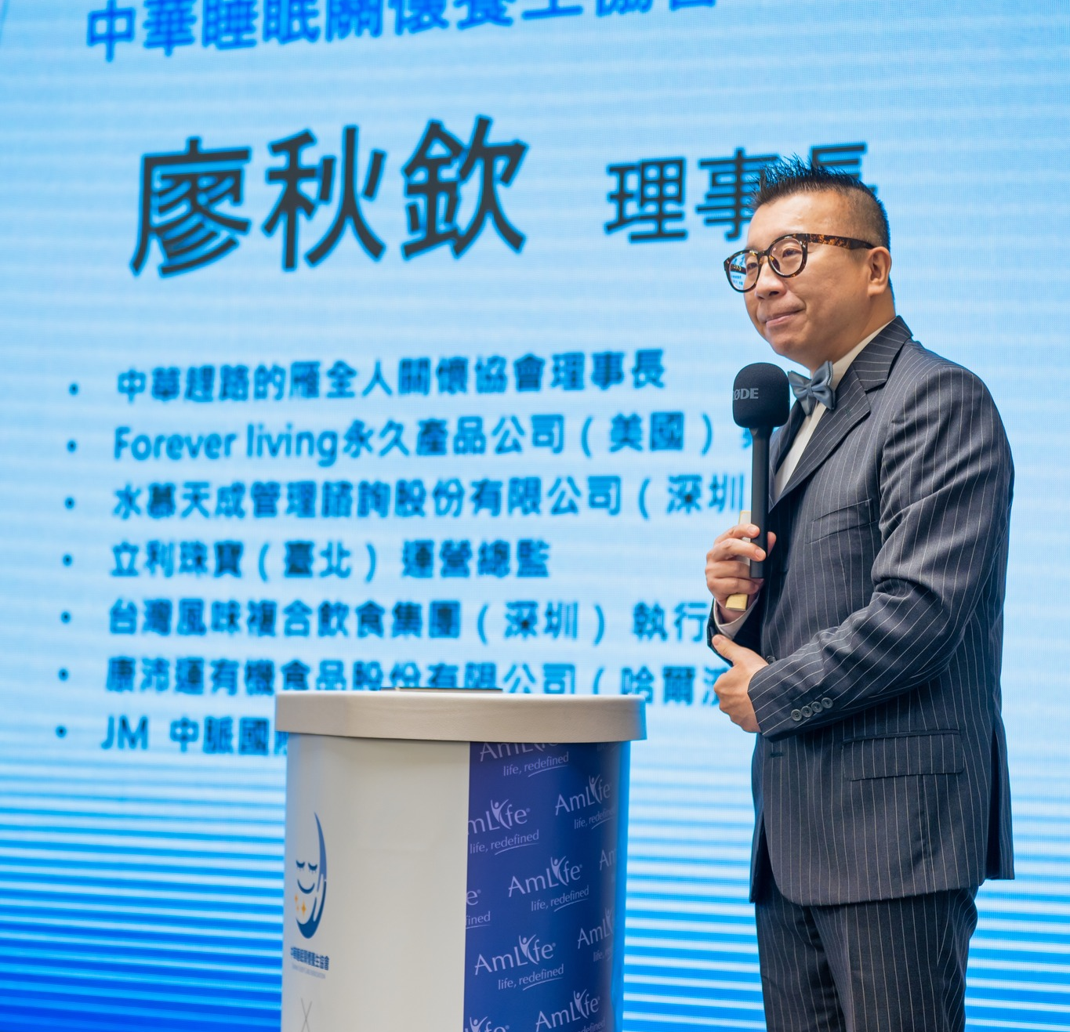
TAIWAN

Slide 16
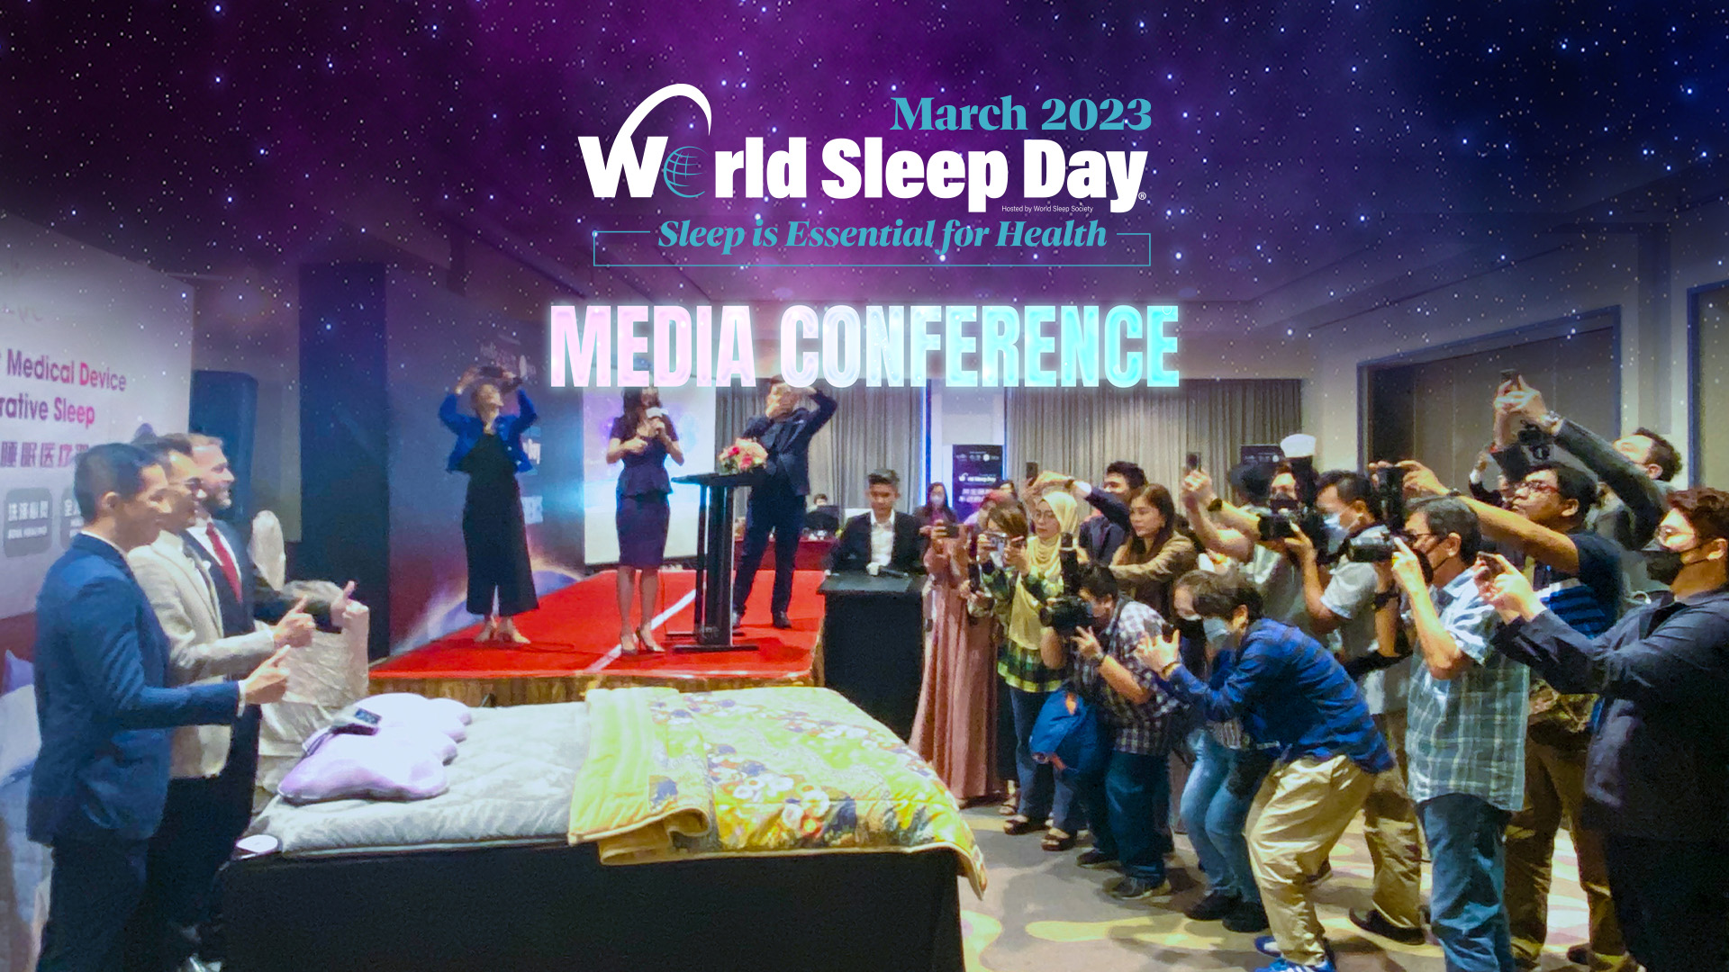
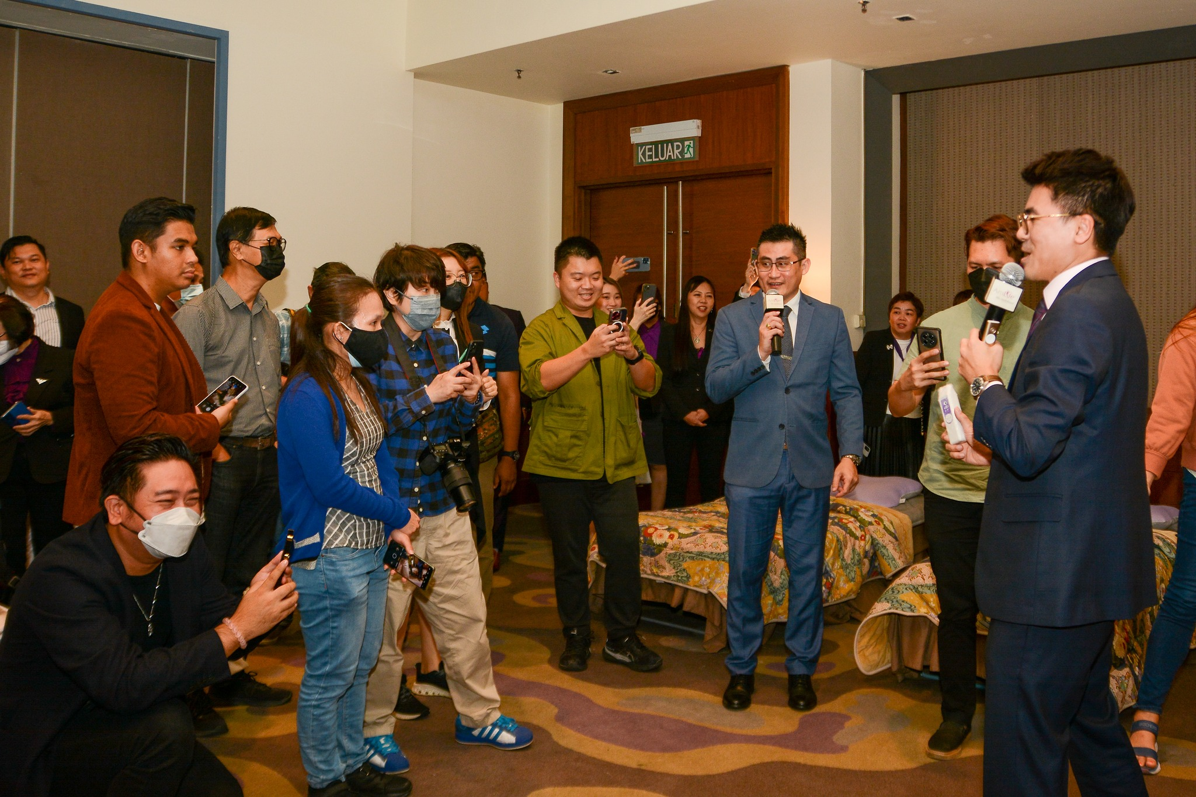
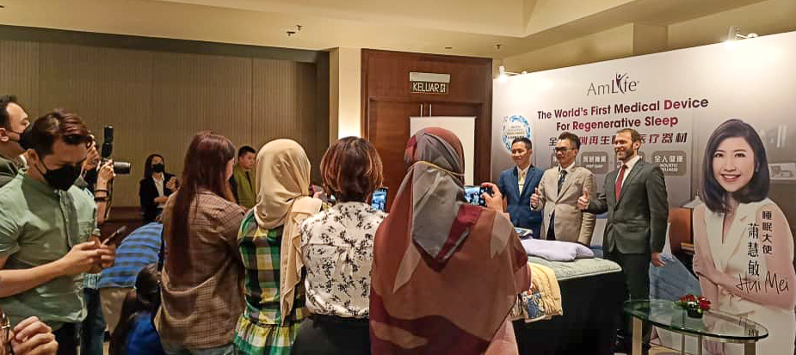
Media Conference
Date : 06 March 2023 (Monday)
Time : 2:00am – 5:00 pm
Venue : Berjaya Times Square Hotel, Kuala Lumpur
Total Media: 700
Dr. Ariel Neikrug, an American sleep expert, Dr. Lim Geng Yan, and Dr. Choo, along with AmLife founder Lew Mun Yee, product director Lew Wai Nan, and nutritionist Mr. KS Chan, answered media questions about sleep wellness and anti-aging on March 6, 2023.
It has been AmLife's mission since the beginning to educate people about the importance of sleep wellness so more people can "Create health from sleep".
We provide a brand-new regenerative sleep solution to help the public sleep soundly, stay away from diseases, and live younger.

Slide 17
Media Exposure (Online)
No. | Media | Link
1 | MalaysiaNews TV | https://mymntnews.com/2023/03/08/amlife-menyokong-tidur-regeneratif-dalam-sambutan-hari-tidur-sedunia/
2 | Malaysian Business Online | http://www.malaysian-business.com/index.php/wordpress/item/7991-amlife-advocates-regenerative-sleep-the-secrets-of-agelessness-as-it-celebrates-world-sleep-day-2023
3 | Business Today | https://www.businesstoday.com.my/2023/03/08/amlife-advocates-regenerative-sleep-the-secrets-of-agelessness-as-it-celebrates-world-sleep-day-2023/
4 | Twenty4Seven Media | https://www.facebook.com/247xMedia/posts/pfbid027hFA1RXr1TxFDUiR2KqS8qQyhtqA5nZiDuNbghaXtvSG68G2DngHv95WeKvoayCUl
5 | Siakap Keli | https://siakapkeli.my/2023/03/08/amlife-sarankan-tidur-regeneratif-rahsia-awet-muda-sempena-sambutan-hari-tidur-sedunia-2023/
6 | Minime Insights | https://www.minimeinsights.com/2023/03/11/amlifes-world-sleep-day-campaign-addresses-rising-sleep-issues-in-malaysia/
7 | Yamcha Time | https://yamchatime.com/amlife-advocates-for-regenerative-sleep-at-sleep-health-showcase/

Slide 18
Media Exposure (Online)
No. | Media | Link
8 | 我要健康 Myhealth | https://myhealthmedia.com.my/amlife-world-sleep-day-2023/
9 | Utusan TV | https://utusantv.com/2023/03/10/amlife-sarankan-tidur-regeneratif-rahsia-awet-muda-sempena-sambutan-hari-tidur-sedunia-2023/
10 | Hello Doctor | https://hellodoktor.com/tidur/tidur-nyenyak/rahsia-awet-muda/
11 | The Malaysian Reserve | https://themalaysianreserve.com/2023/03/17/addressing-insomnia-sleep-disorders/
12 | 风采 Feminine | https://feminine.com.my/my-wellness/health-info/%e4%bf%9d%e5%81%a5%e8%b5%84%e8%ae%af%ef%bd%9c%e9%85%8d%e5%90%882023%e5%b9%b4%e4%b8%96%e7%95%8c%e7%9d%a1%e7%9c%a0%e6%97%a5%e5%ba%86%e7%a5%9d%e6%b4%bb%e5%8a%a8-amlife%e5%a4%a7%e5%8a%9b%e5%80%a1%e5%af%bc/
13 | New Straits Times | https://www.nst.com.my/lifestyle/heal/2023/03/890304/health-malaysians-are-seriously-sleep-deprived
14 | New Straits Times | https://www.msn.com/en-my/news/national/supernumberhealth-malaysians-are-seriously-sleep-deprived/ar-AA18N8Bh

Slide 19
Media Exposure (Online)
No. | Media | Link
15 | Getaran | https://www.getaran.my/artikel/semasa/42848/pameran-kesihatan-tidur-amlife-bantu-rakyat-malaysia-atasi-pelbagai-masalah-isu-kekurangan-tidur
16 | Feminine FB Page | https://m.facebook.com/story.php?story_fbid=pfbid02WmjLd5oHYQrCz642gLTiLoc2DB3xHFSAsTdm9LKHrNGatrDReRwdT1QUuzvA2Akal&id=100064425170025&sfnsn=mo&mibextid=RUbZ1f
17 | Parenthood | https://parenthood.my/lifestyle/amlife-advocates-for-malaysians-to-achieve-better-sleep-through-its-regional-sleep-health-showcase/

Slide 20
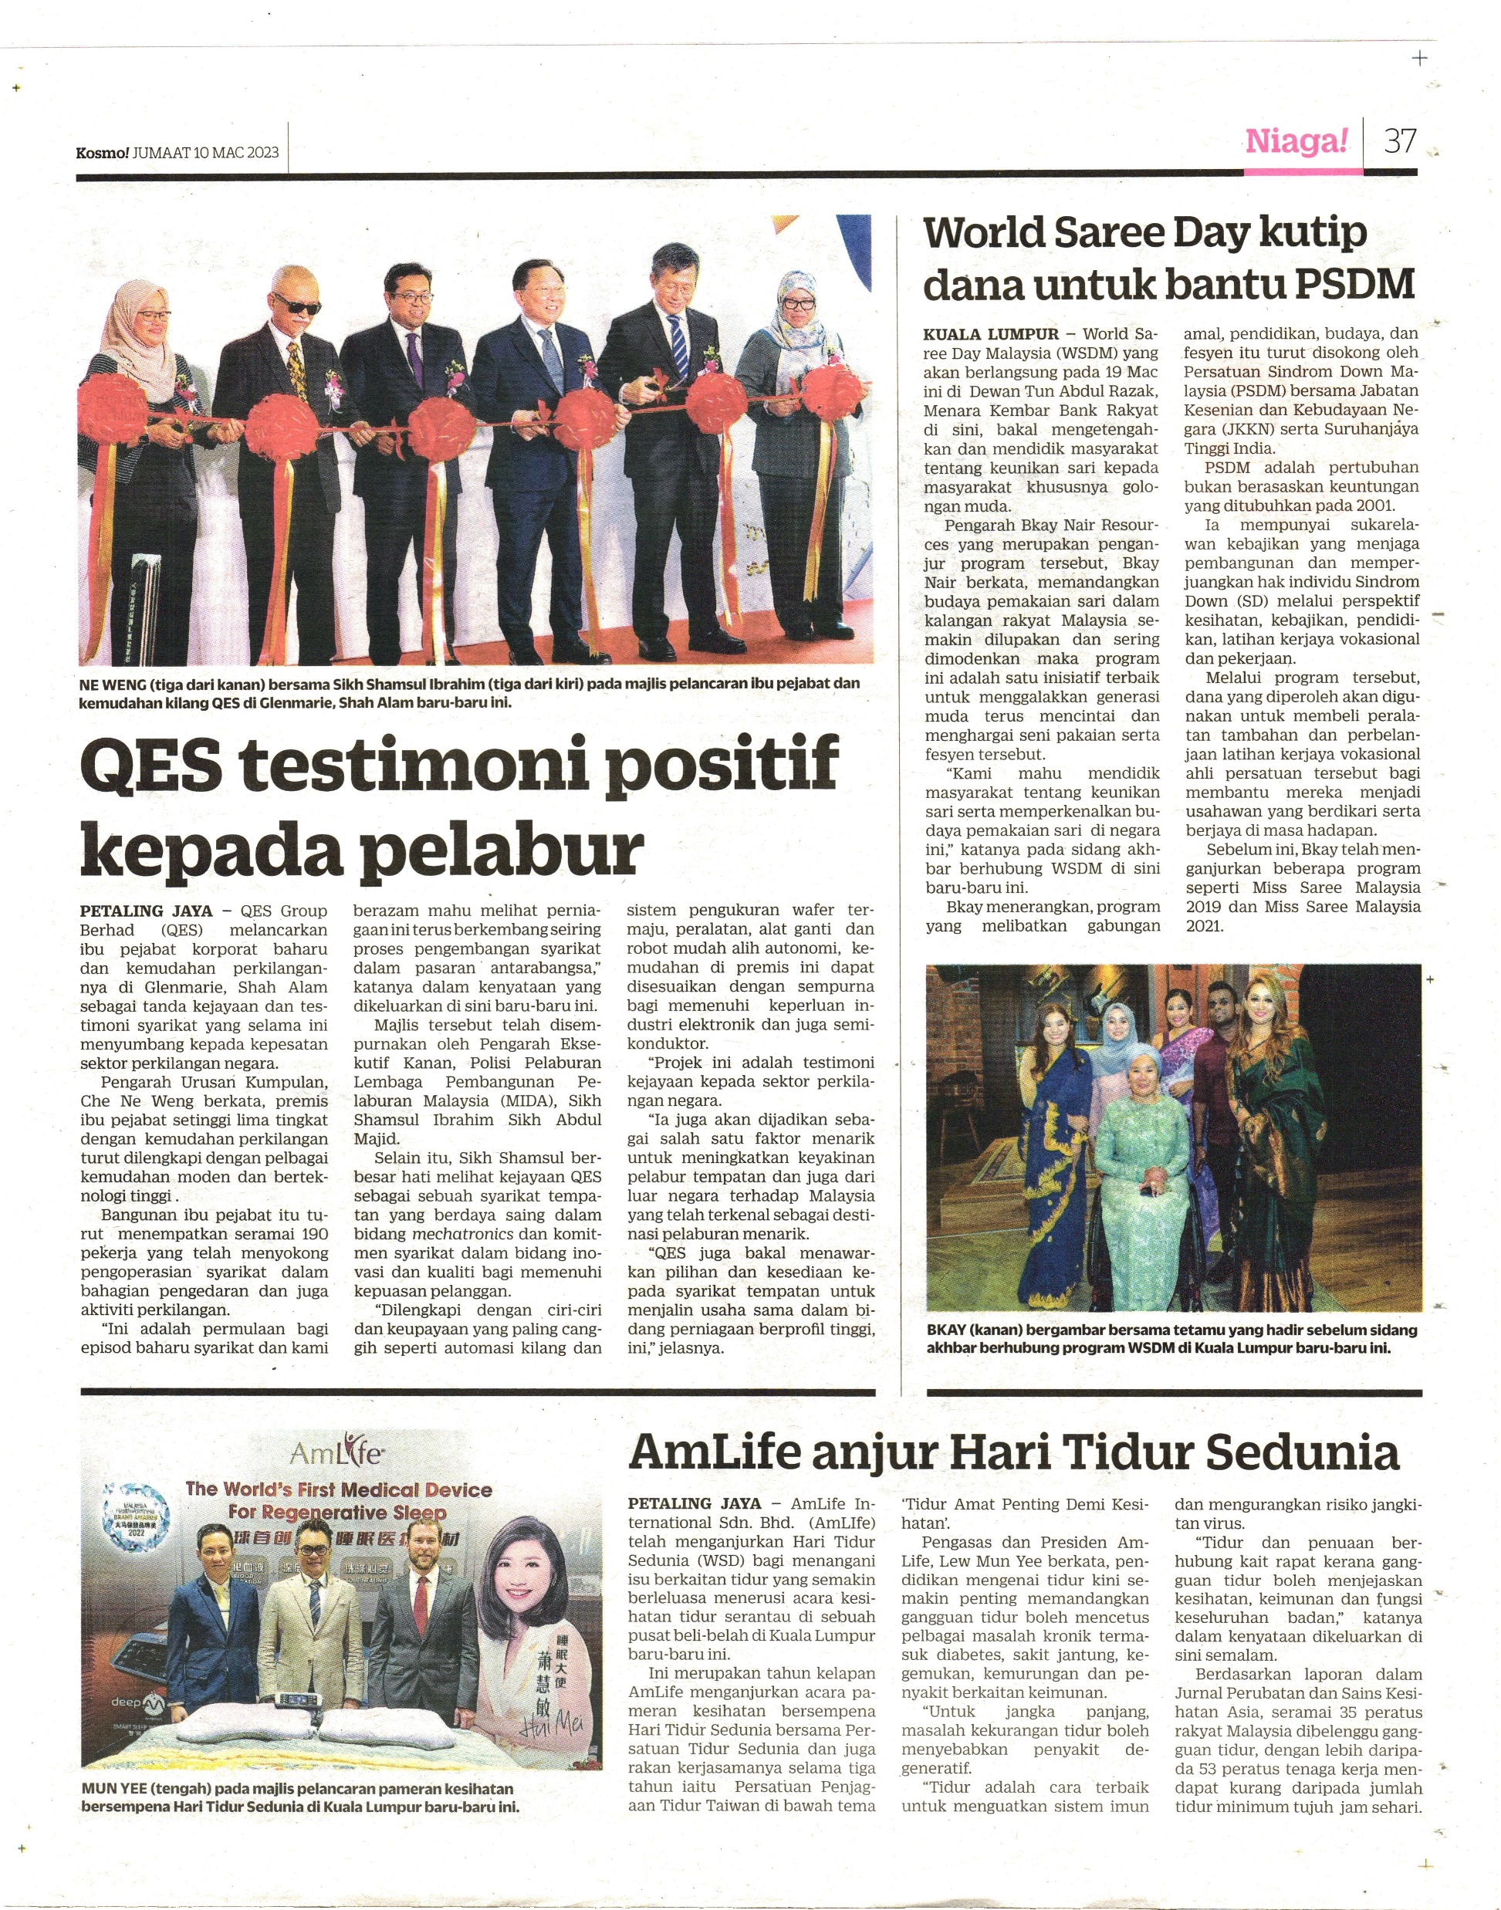
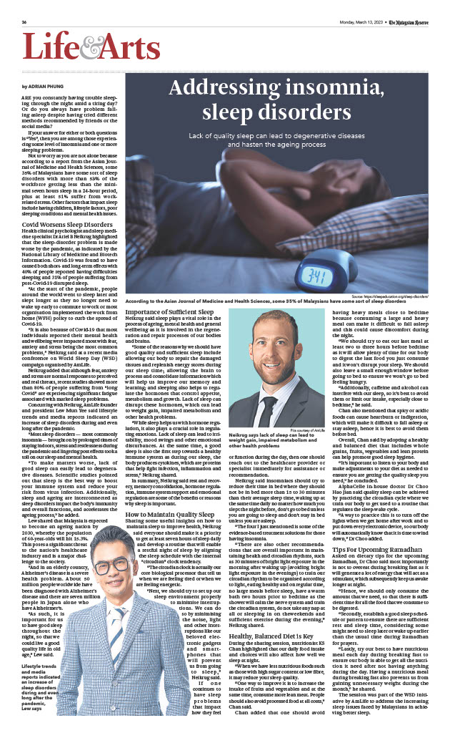
Media Release (Newspaper)

Slide 21
Recharge Your Health In Sleep

