Slide 1
Presented by World Sleep Society

Slide 2
2019 Slogan
“Healthy Sleep, Healthy Aging”

Slide 3
World Sleep Day® is an annual event, intended to be a celebration of sleep and a call to action on important issues related to sleep, including medicine, education, social aspects and driving. It aims to lessen the burden of sleep problems on society through better prevention and management of sleep disorders.

Slide 4
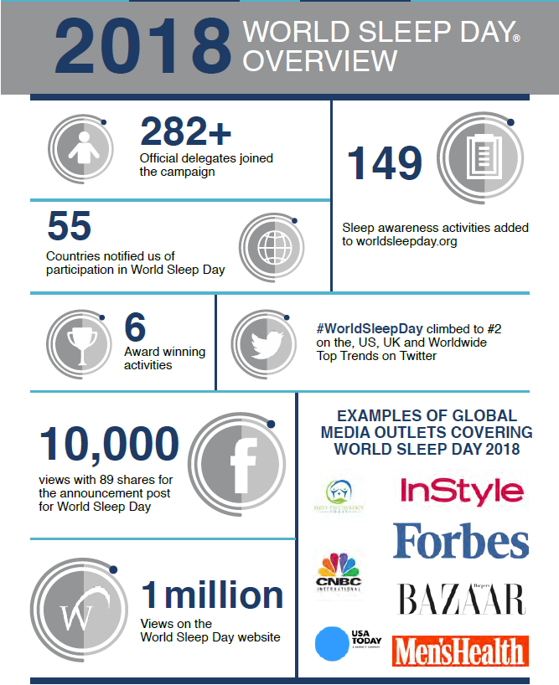

Slide 5
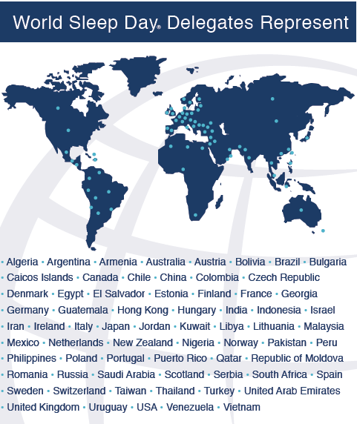

Slide 6
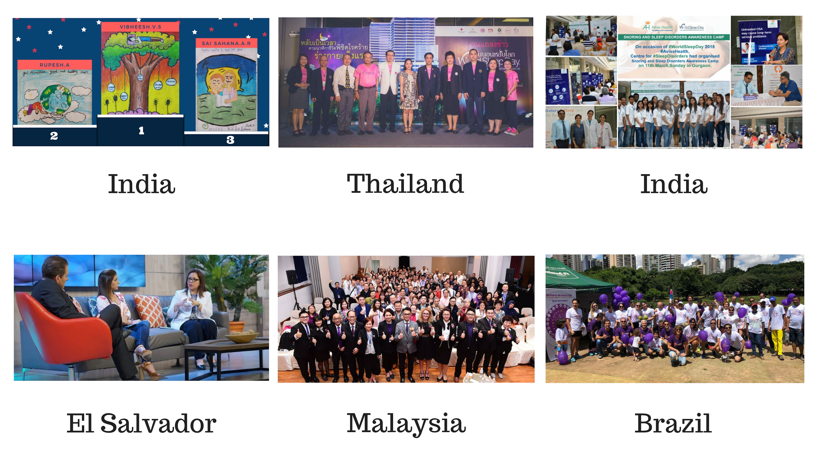
Distinguished Activity Award Winners

Slide 7
Become a World Sleep Day Delegate @
worldsleepday.org/become-a-delegate

Slide 8
Submit your activity @
worldsleepday.org/submit-your-activity

