Slide 1
BOLIVIA WSD 2018
‘Join the Sleep World, Preserve Your Rhythms to Enjoy Life,’

Slide 2
CONFERENCE TO COLEGUES

Slide 4
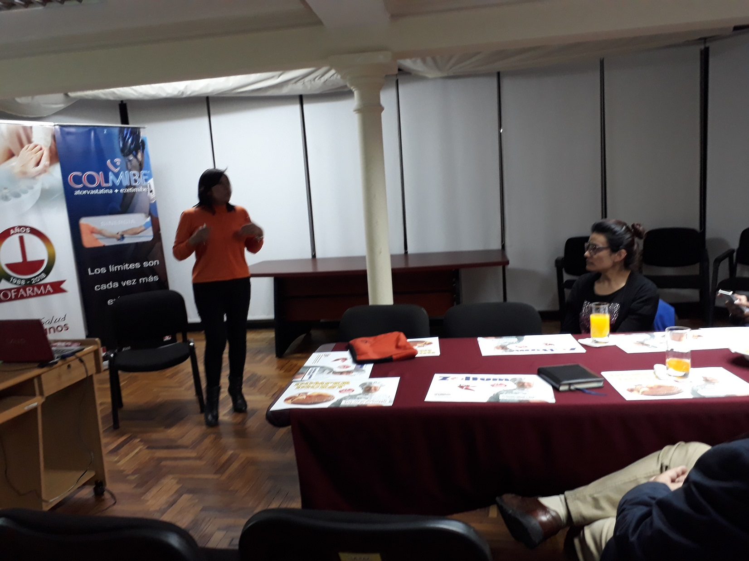

Slide 5
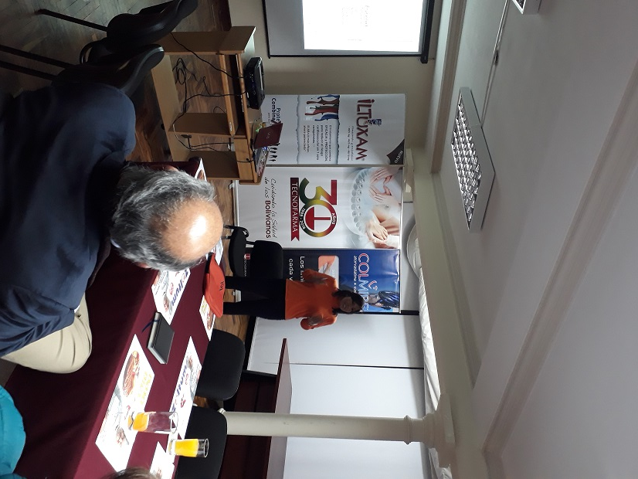

Slide 6
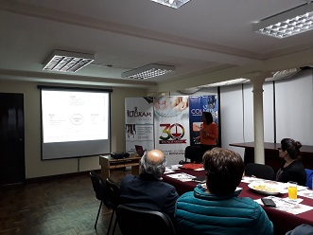

Slide 7
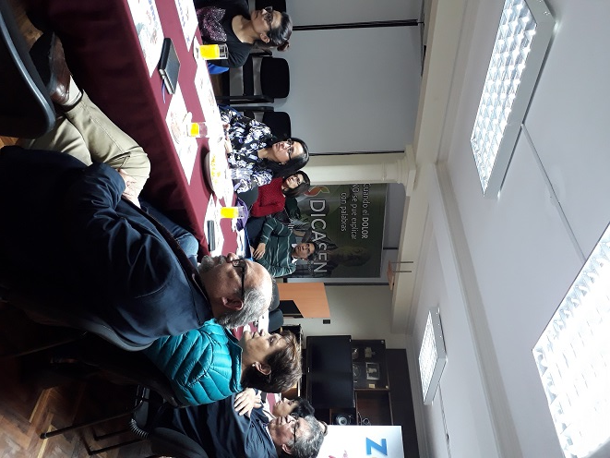

Slide 8
POTERS TO PUBLIC
THE ONE THOUSAND AND ONE POSTERS

Slide 10
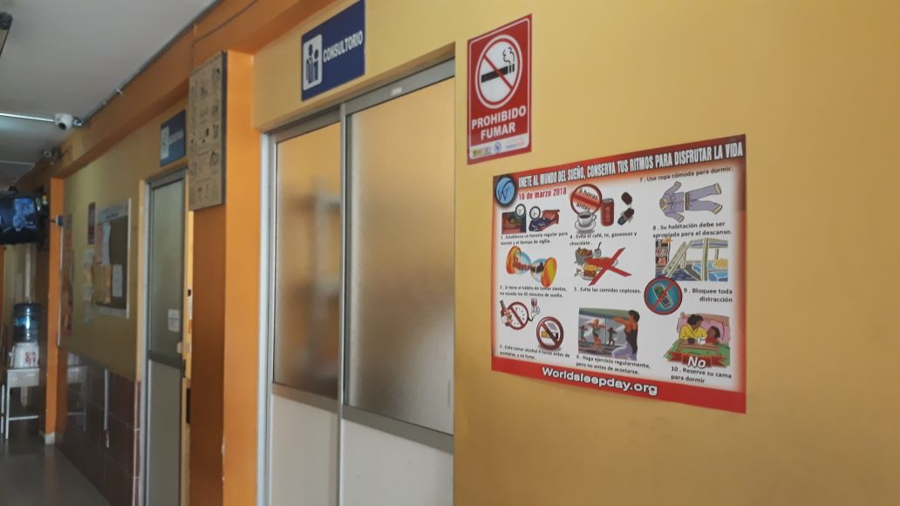

Slide 11
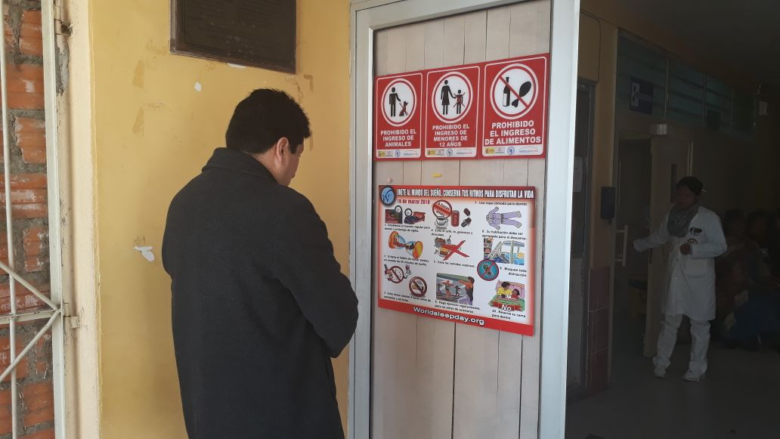

Slide 12
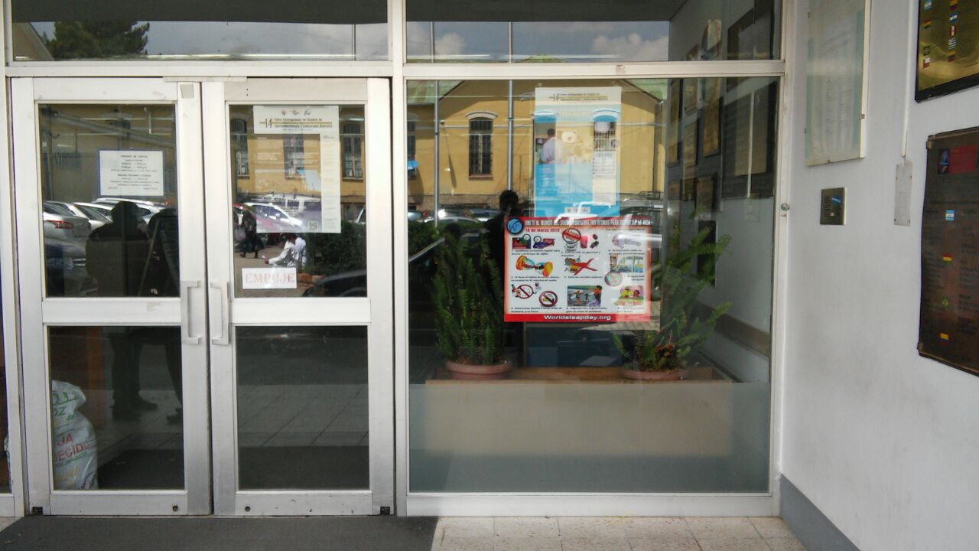

Slide 13
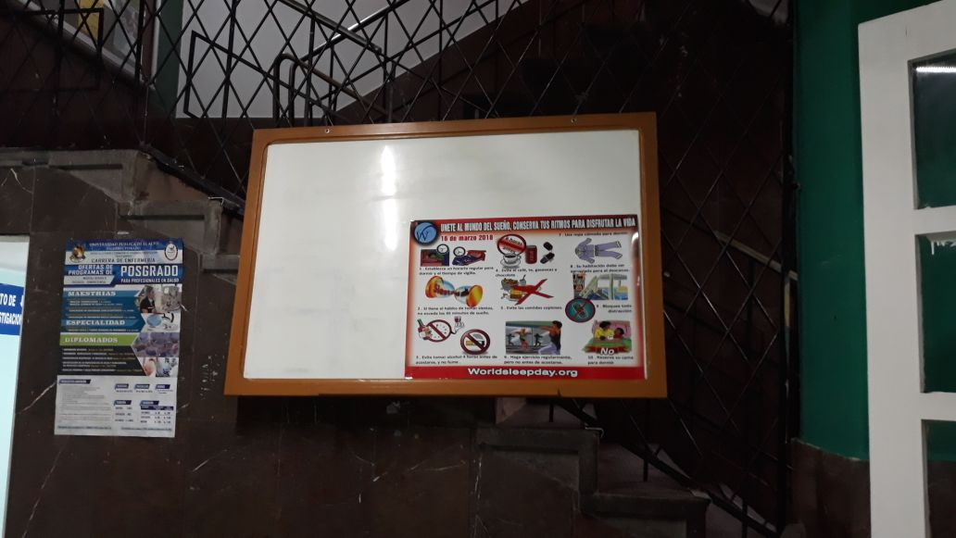

Slide 14
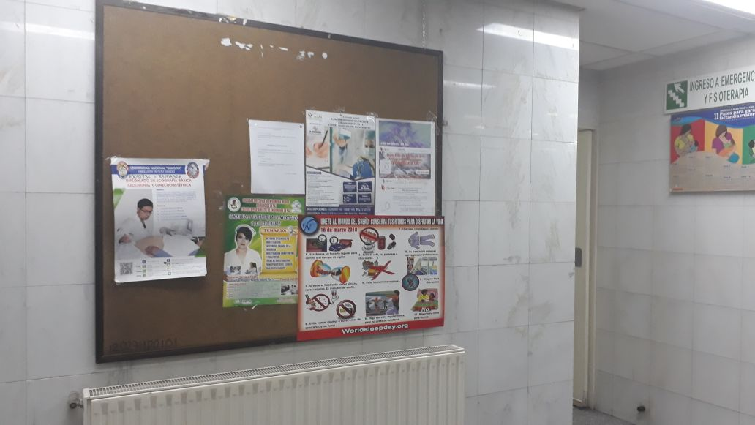

Slide 15
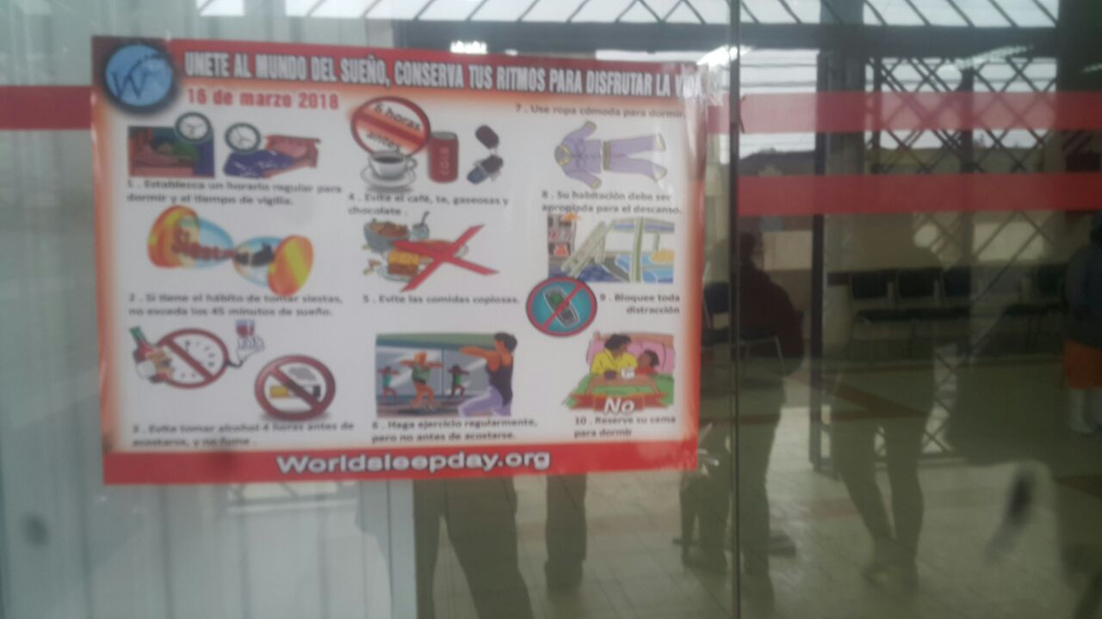

Slide 16
INTERVIEWS

Slide 20
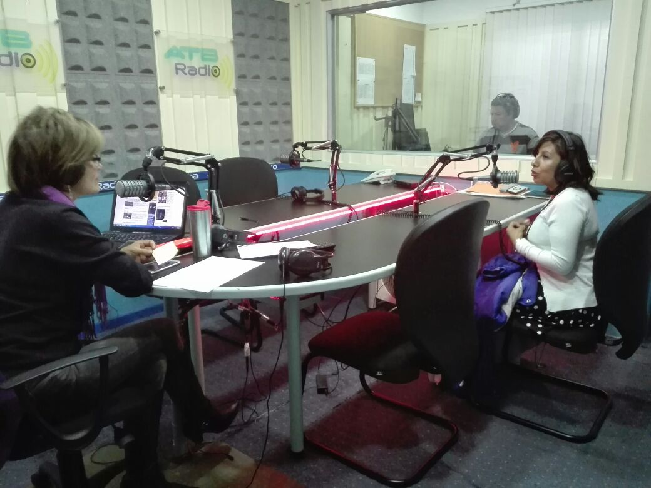

Slide 21
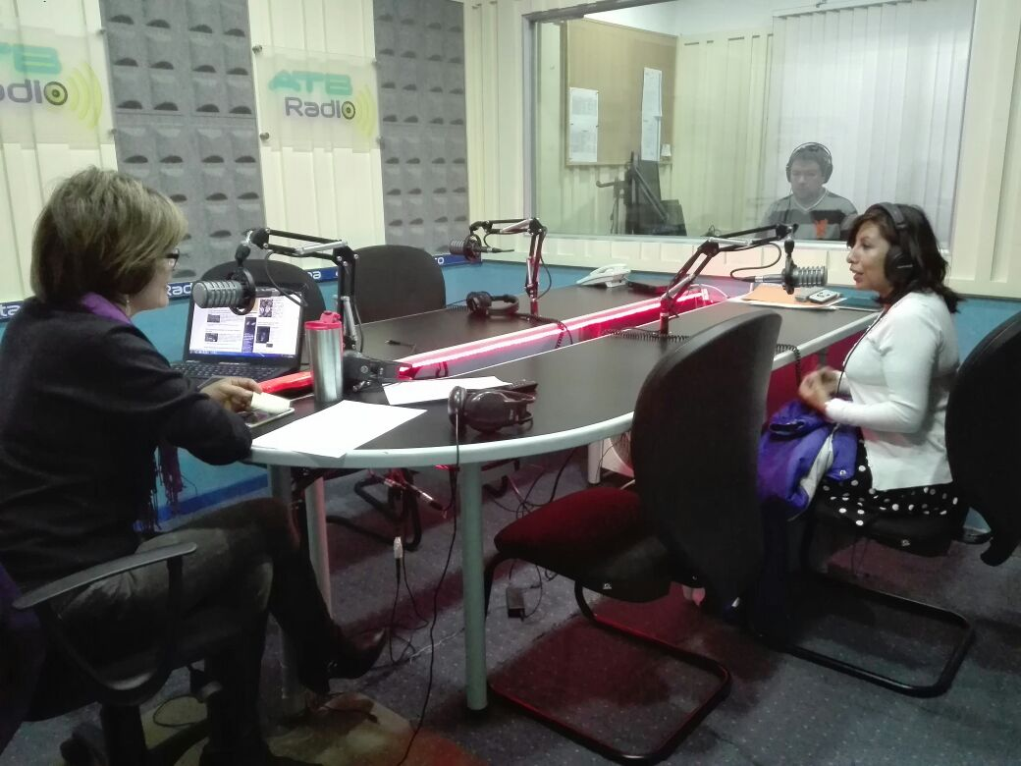

Slide 22
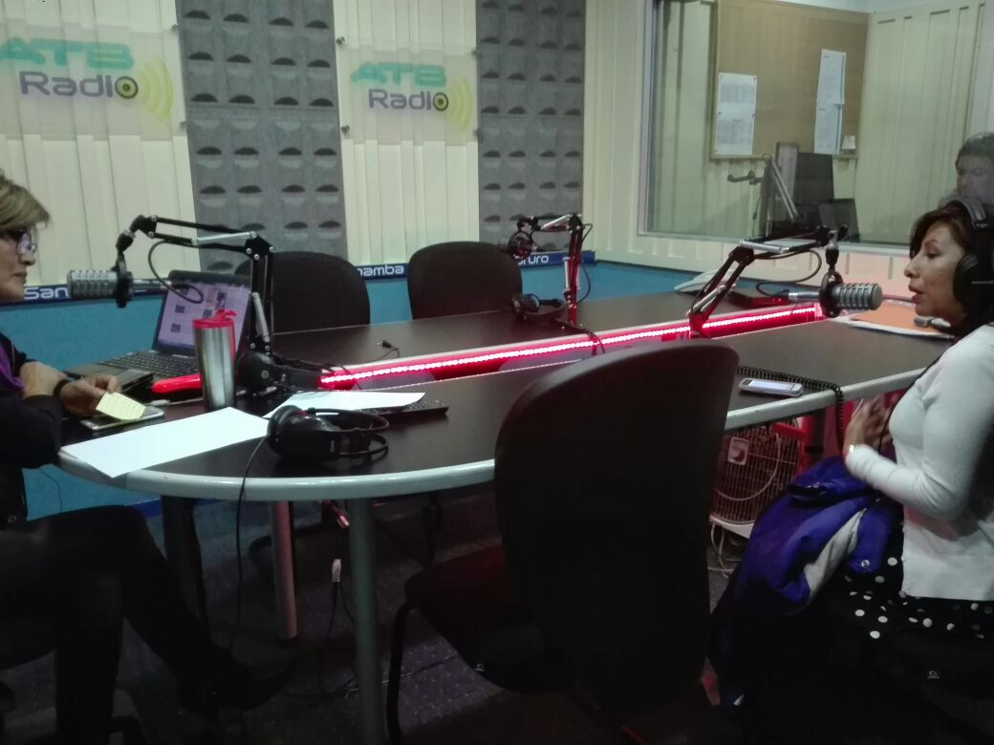

Slide 24
BOLIVIA IS THE DREAM OF LOS ANDES

